Slide 1



Slide 2

Tourist Guide Android Application
Supervised by:
Sir Bilal Haider Bukhari
Group Members:
Mahmood Ali Khan( FA18-MCS-040 )
Marwa Naz( SP19-MCS-017 )
Presented on 07 December, 2020
Department of Computer Science
COMSATS University Islamabad
Attock Campus

Slide 3
Outline
_______________________________
Introduction
Working flow
Comparison table
Problem statement
Objectives
Interface
Methodology
Modern tools
Benefits
References
_______________________________

Slide 4

Introduction
“Tourist Guide Android Application” is developed for guidance and help of tourists who are interested in visiting Pakistan’s beautiful locations and tourist points.
This app will helpful both for local and international tourists who wanted to visit Pakistan’s beautiful places.
User can find out the restaurants’ list of specific tourist points along with their ratings.
Online booking services of different restaurants will also be possible through this app.

Slide 5
Continued...
By using this app user can find out the location of different tourist points through google map.
This app will also provide information about PIA and Pakistan Railway tickets availability.
User will also be able, to share their experiences through pictures and notes.

Slide 6
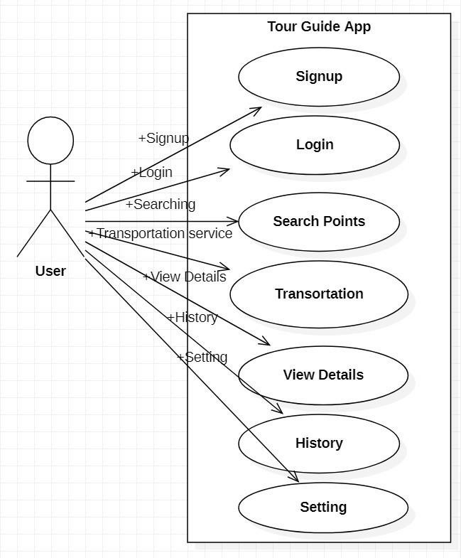
Working Flow :Use case Diagram

Slide 7
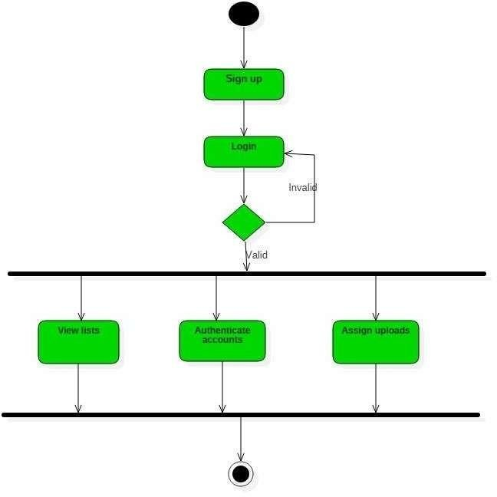
Tourist Activity Diagram

Slide 8


Tourist Sequence Diagram

Slide 9
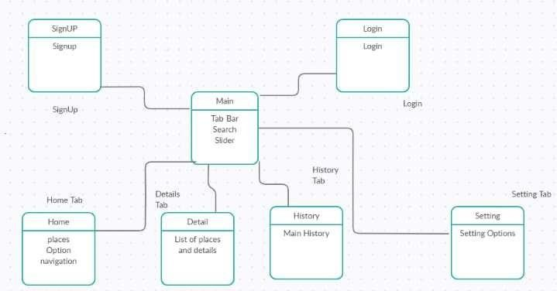
Tourist Data Flow Diagram

Slide 10
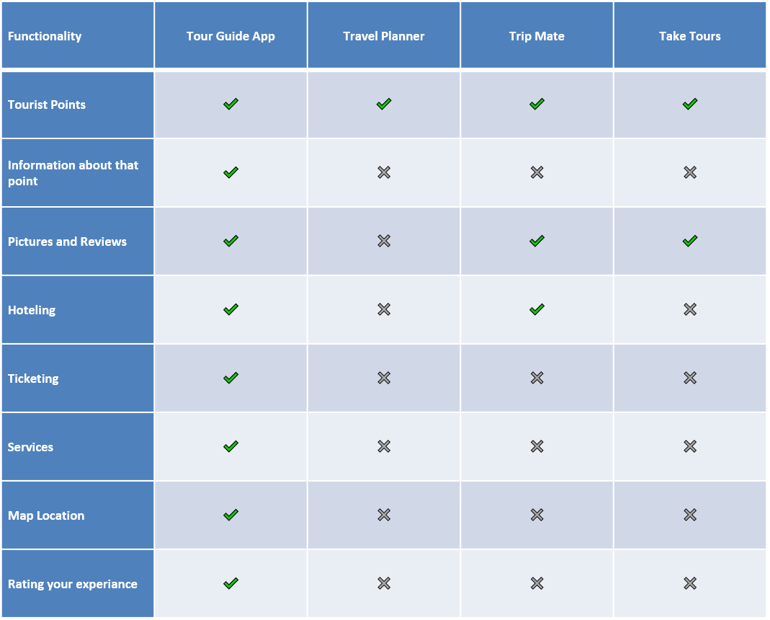
Comparison Table

Slide 11
Problem Statement
As local and international tourists faces difficulties in finding of different tourist points in Pakistan.
Some of main issues are:
To find out the best hotels and their services on different tourist points in minimum time.
Finding the exact location of a tourist point.
Finding of transportation services availability at that areas.

Slide 12
Objectives
The main aims and objectives of our system are:
To provide a “user friendly platform”.
To provide the location of different tourist points, through google map.
To provide list of hotels and their services.
To provide online booking system for hotels.
To provide information about different service providers on a particular tourist point.
To provide information about Pakistan railway and PIA tickets availability.

Slide 13
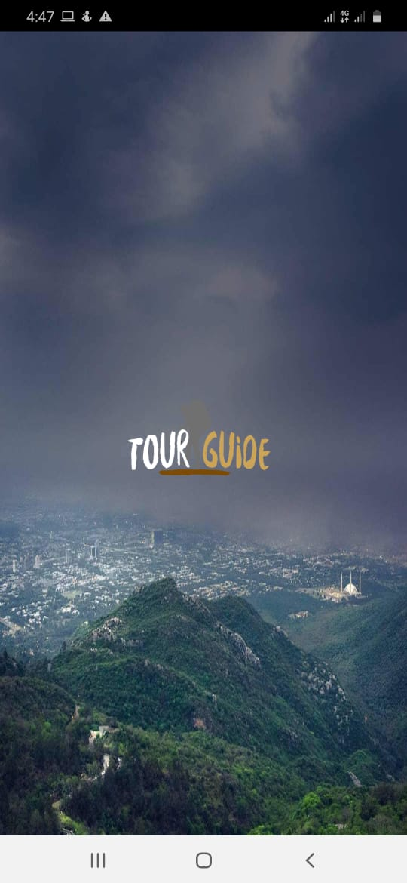
Interfaces: Splash Screen

Slide 14
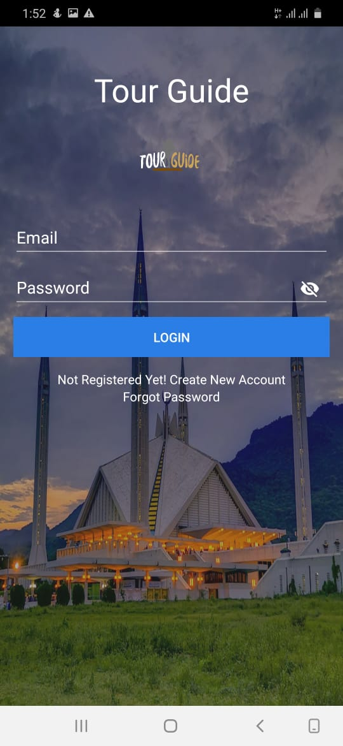
Login

Slide 15
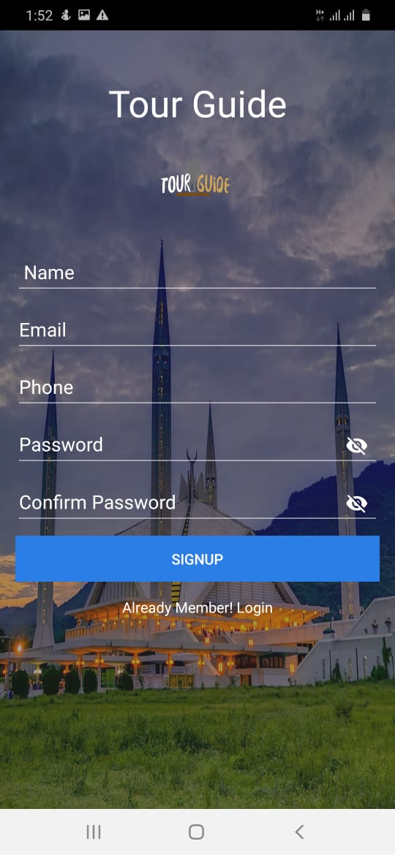
Registration

Slide 16
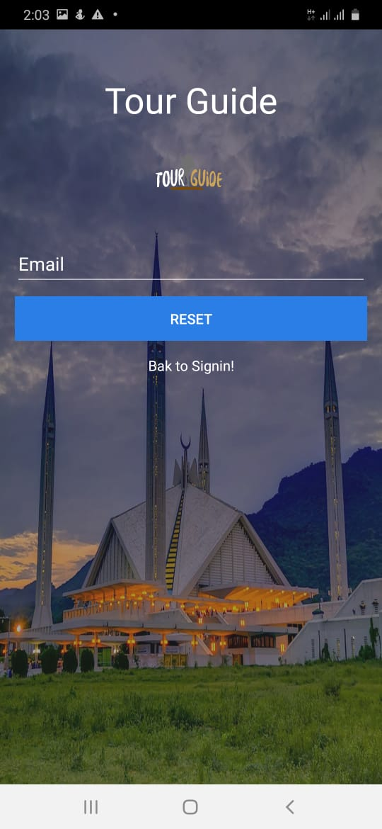
User Forgot Password

Slide 17
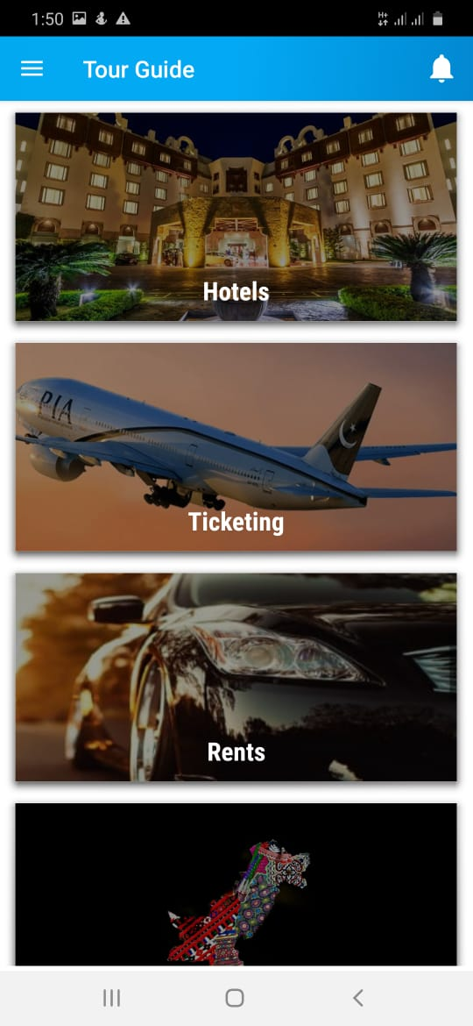
Home

Slide 18
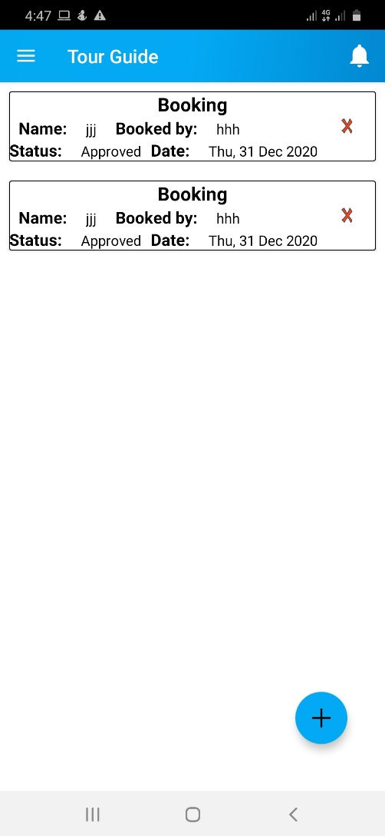
Booking

Slide 19
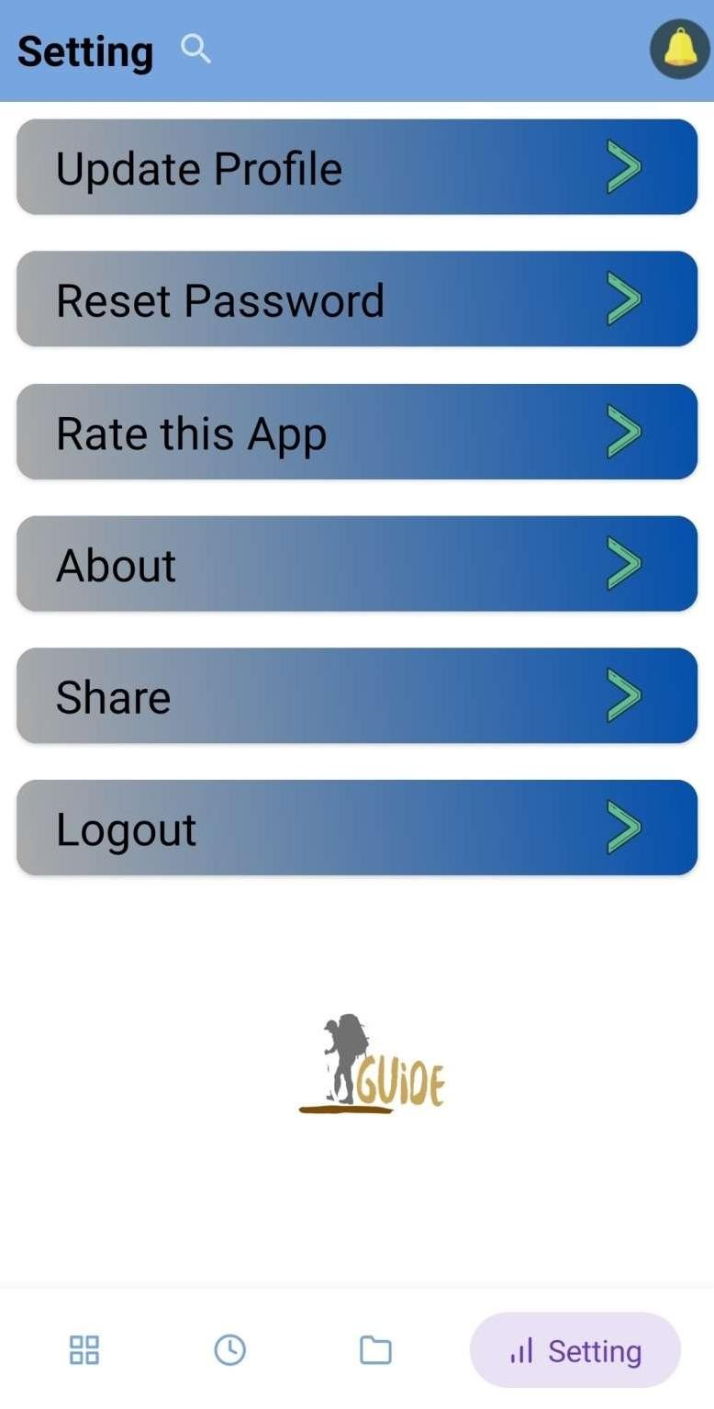
Settings

Slide 20
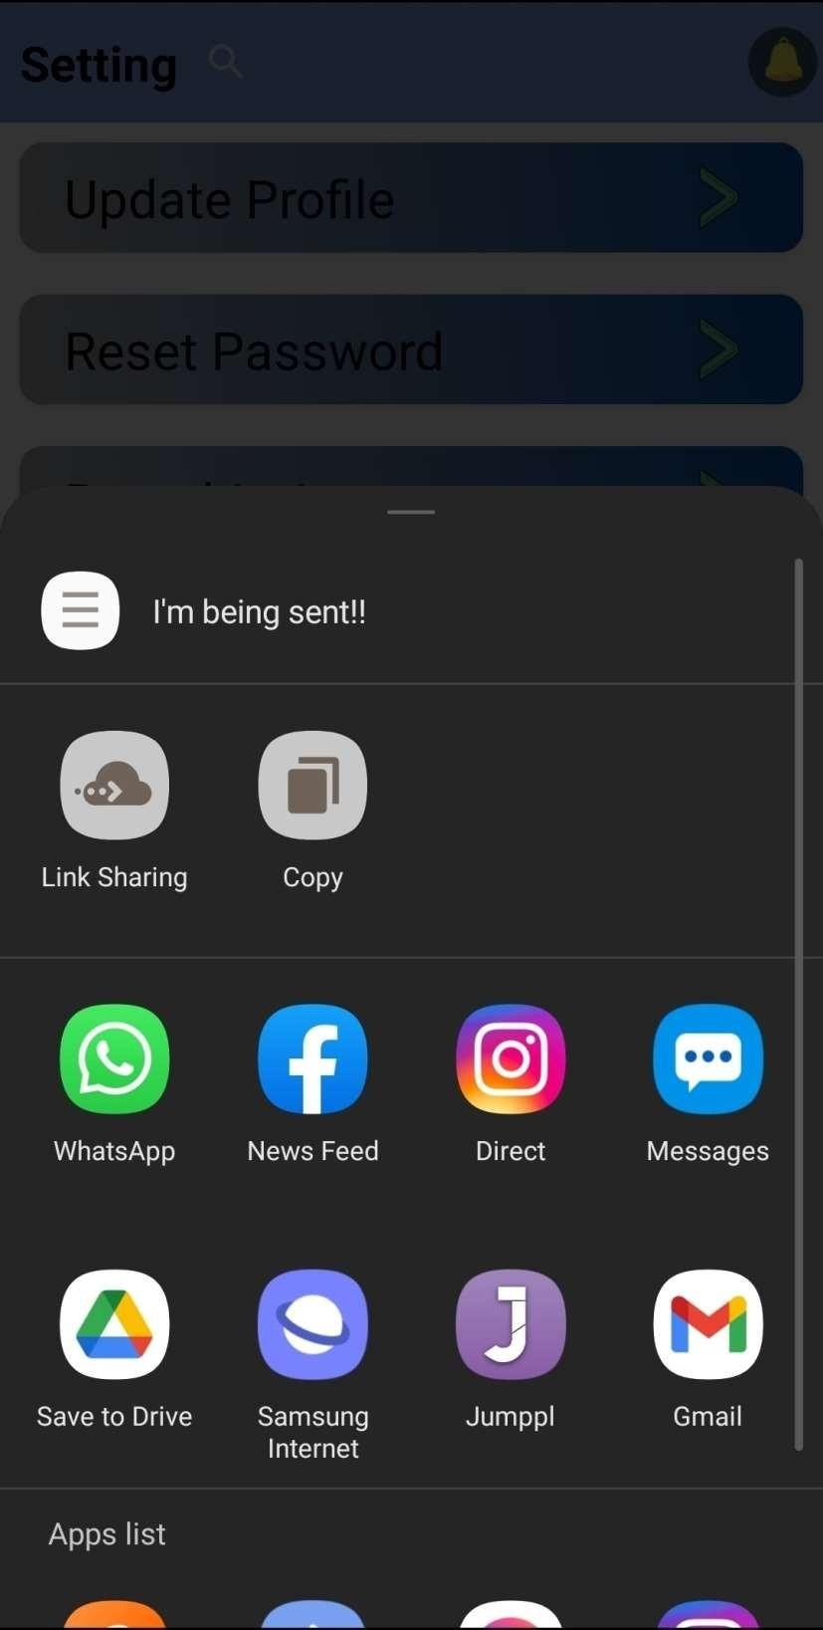
Share Popup

Slide 21
Methodology
Users have to log-in to his profile after registration, in order to use some main features of the app like online hotel booking.
After log-in user will see different interfaces, like Home interface, Office and Market interface.
Each interface will have different categories like home interface have following categories:
Find Tourist Points, Services, Ticketing etc.
Hotels rating and their food menu will also be provided along with other information.

Slide 22
Tools and Technologies
Tools | Version | Rationale
MS Visio | 2013 | UML Diagram Designs
Android studio | 3.4 | Coding and templates design
MS Word | 2013 | Documentation
MS PowerPoint | 2013 | Presentation work

Slide 23
Benefits
User friendly interface.
Easy in finding locations of tourist points.
Reduce dependency.
Easy in finding best hotels.
Easy in finding information about PIA and Pakistan railway tickets availability.
Tourist will be able to share their experiences.

Slide 24
References
References
[1]. https://thediplomat.com/2020/01/the-quest-to-revive-tourism-in-pakistan/
[2]. https://www.cntraveller.com/gallery/best-holiday-destinations-2021
[3]. http://www.radio.gov.pk/29-12-2019/bbs-declares-pakistan-the-worlds-3rd-highest-potential-adventure-destination-for-2020
[4]. https://firebase.google.com/
[5]. https://en.wikipedia.org/wiki/System_testing
[6]. https://en.wikipedia.org/wiki/Google_Maps

Slide 25


Slide 26
References
1. https://thediplomat.com/2020/01/the-quest-to-revive- tourism-in-pakistan/
2. https://www.cntraveller.com/gallery/best-holiday- destinations-2021
3. http://www.radio.gov.pk/29-12-2019/bbs-declares- pakistan-the-worlds-3rd-highest-potential-adventure-destination-for-2020
4. https://firebase.google.com/
5. https://en.wikipedia.org/wiki/System_testing
6. https://en.wikipedia.org/wiki/Google_Maps

